Slide 1

Improving Pet Adoption Rates A Data-Driven Approach by APL Portage

Slide 2

Team members – GROUP 10
Venu Dodda
Meghana Udiga
Chaitanya Reddy
Shreya

Slide 3
AGENDA
Introduction
Objective
Dashboard
Adoption Trends and Programs
Executive summary

Slide 4

INTRODUCTION
A Pet Adoption Dashboard is a comprehensive tool designed to help APL Portage to monitor and optimize its efforts to increase pet adoptions and reduce the number of surrendered pets. The primary objective of this initiative is to implement effective programs in cities with lower adoption rates to enhance the rate of pet adoption. By rigorously evaluating the impact of these programs over time, we aim to increase the number of permanent homes for pets, ultimately improving the welfare of companion animals and the communities in which they reside. This dashboard provides real-time data and insights to help APL track their progress towards these goals, identify areas for improvement, and make data-driven decisions to optimize their programs and resources.

Slide 5

Objective
The primary objective is to augment the adoption rate of pets and diminish the incidence of pet surrender by implementing effective programs in cities with lower adoption rates and evaluating their efficacy over time.

Slide 6
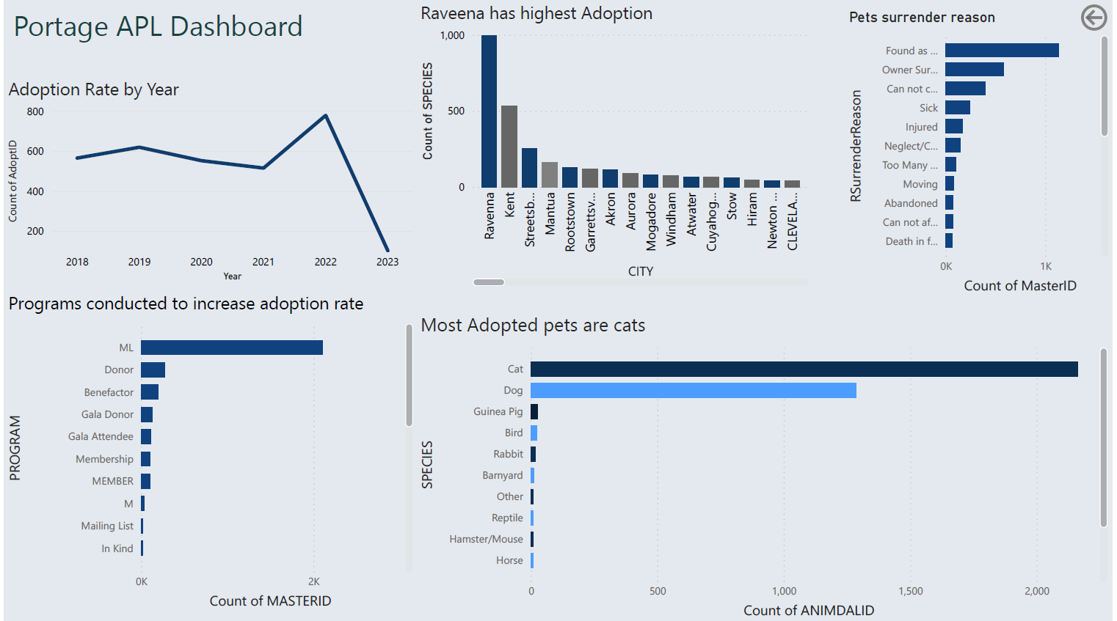

Slide 7

Adoption Trends and Programs
Adoption Trends
Cats are the most adopted pets, followed by dogs.
Adoption Locations
Ravenna has had the highest number of adoptions, followed by Kent.
Reasons for Surrender
Strays are the most common reason for pets being surrendered.
Adoption Programs
The Mailing List program has been the most effective in increasing adoptions, followed by the Donor program.

Slide 8

Executive summary
The APL Portage aims to increase pet adoption rates while decreasing the number of surrendered pets by implementing effective programs in cities with lower adoption rates. A Pet Adoption Dashboard has been designed to monitor and optimize their efforts towards this objective. The dashboard provides real-time data and insights to track progress, identify areas for improvement, and make data-driven decisions to optimize programs and resources. Adoption trends reveal an increase in the adoption rate for pets in recent years, with cats being the most adopted pets, followed by dogs. Ravenna has the highest number of adoptions, followed by Kent. Strays are the most common reason for pets being surrendered. APL Portage has implemented several programs to increase adoptions, with the Mailing List program being the most effective, followed by the Donor program. By evaluating the efficacy of these programs over time, APL Portage aims to increase the number of permanent homes for pets, improving the welfare of companion animals and communities.

Slide 9

Thank you

